Slide 1
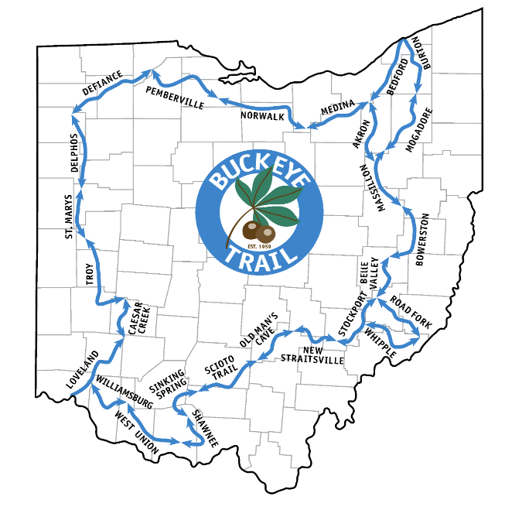
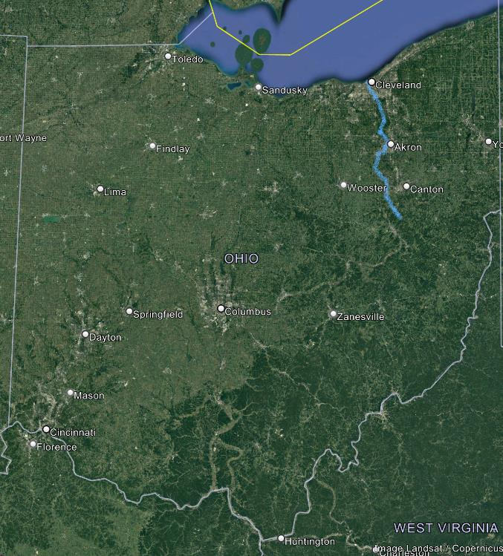


Sibling Hike 1
Buckeye Trail 15-22 May 2022
Notes:
This will be a Pecha Kucha description of a 1-week walk in OH I did with my siblings in May 2022. The Buckeye Trail is a 1,444 mile loop trail around Ohio as shown in the map on the left. We walked the section highlighted in blue on the right map, about 113 miles over 8 days.
I have been doing some long-distance hikes like the Santiago trail over the last several years, and with Omar and Dante had discussed trying to do a section of the Appalachian Trail, but one ofsuggested we try
The first 20 miles were dedicated on September 19, 1959 in Hocking County. Several of the founders and early leaders were among the 34 people making that dedication hike, including the BTA's most famous grandma, Emma Gatewood. From that beginning, the trail grew to over 1,444 miles under the auspices of the BTA. It was completed near Deer Lick Cave in the Cuyahoga Valley National Recreation Area in 1980.
Ohio's Hiking Great-Grandmother:
Emma Gatewood (1888-1973)
After raising 11 children on farms along the Ohio River and at the age of 67, the grandmother of 23 became the first woman to thru-hike the Appalachian Trail alone and in a continuous hike. That was in 1955. Two years later, she hiked the Appalachian Trail again and later completed a third hike of the trail in sections. She is known for her legendary Keds sneakers that she wore instead of hiking boots and the laundry sack that she used instead of a backpack. Many call “Grandma” Gatewood the first thru-hiker celebrity. She appeared on the Today show and numerous other programs. She inspired two distinct movements in hiking—long-distance hiking for women and the ultra-lite movement. She carried just a few items with her, each chosen carefully so they could perform multiple functions. Including food, water and equipment, she rarely carried more than 20 pounds.

Slide 2
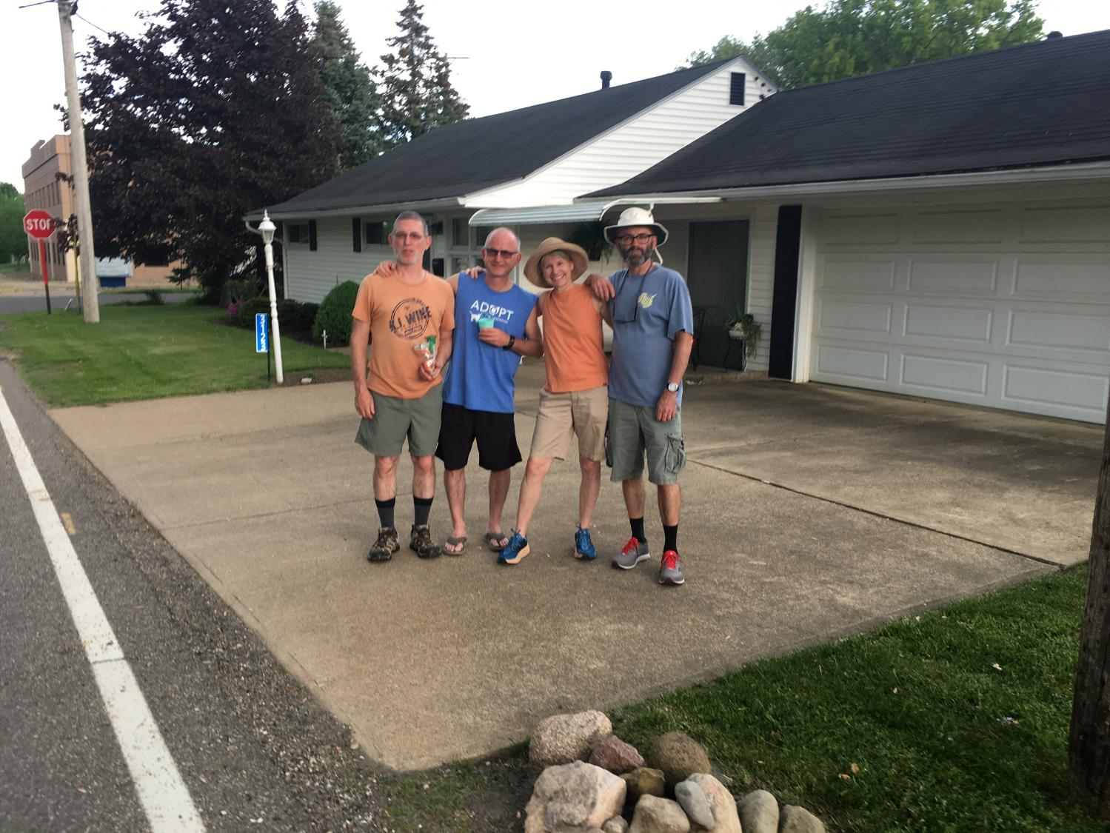
Notes:
Kirt couldn’t join us due to his recent hip surgery, but Rob, Jody, Dante, Omar, and I met in Massillon, where we rented a house for the first 4 nights. Very close to our “Little” Grandma’s former house shown here that we all have many fond memories of. We bought a bag of orange slices, one of her favorite candies, to enjoy together.

Slide 3
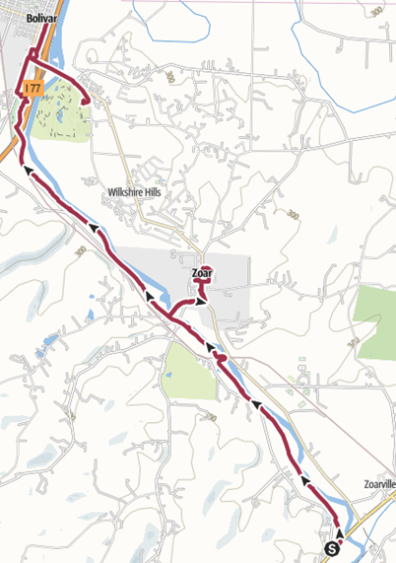
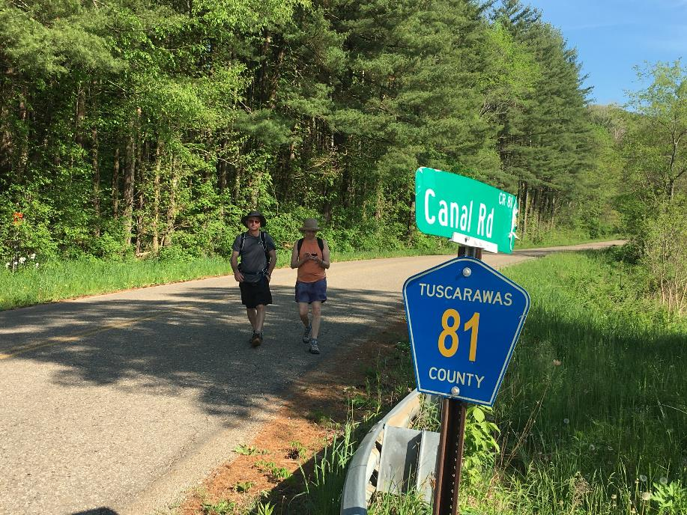
Notes:
This part of the path follows the towpath of the Ohio and Erie Canal, and our first day started appropriately along Canal Road near Zoarville. We had a nice 10.7 mile walk to Bolivar (yep, named after Simone Bolivar, liberator of Columbia), stopping for our picknic lunch in Zoar, village of a religious separatist group that peaked in the late 1800s.

Slide 4
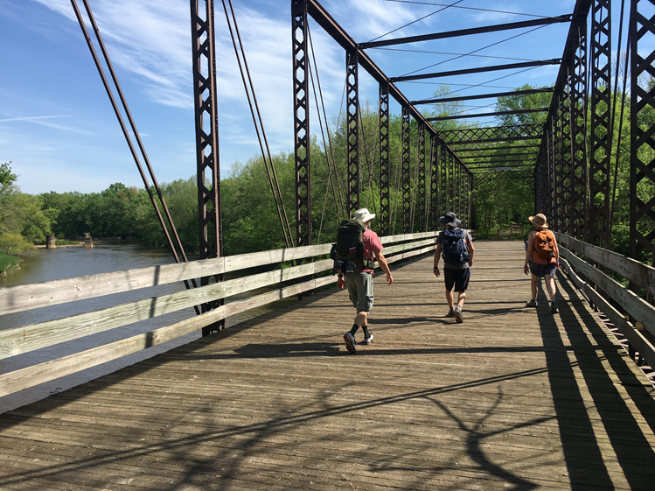
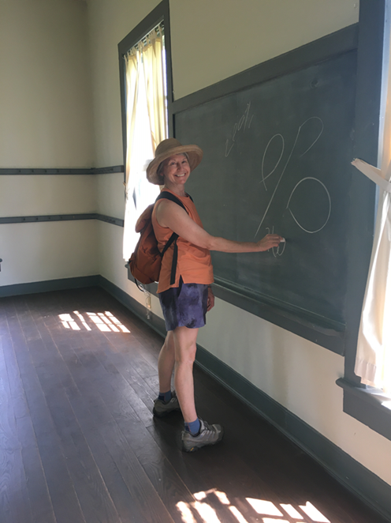
Notes:
Jody remembered Big Grandma taking her to visit Zoar, and we sidetracked over the Tuscarawas River via a pedestrian iron bridge to visit the quaint town. We met a worker who let us in to the old schoolhouse, an impressive building for a town of 500, showing they valued education for both boys and girls.

Slide 5
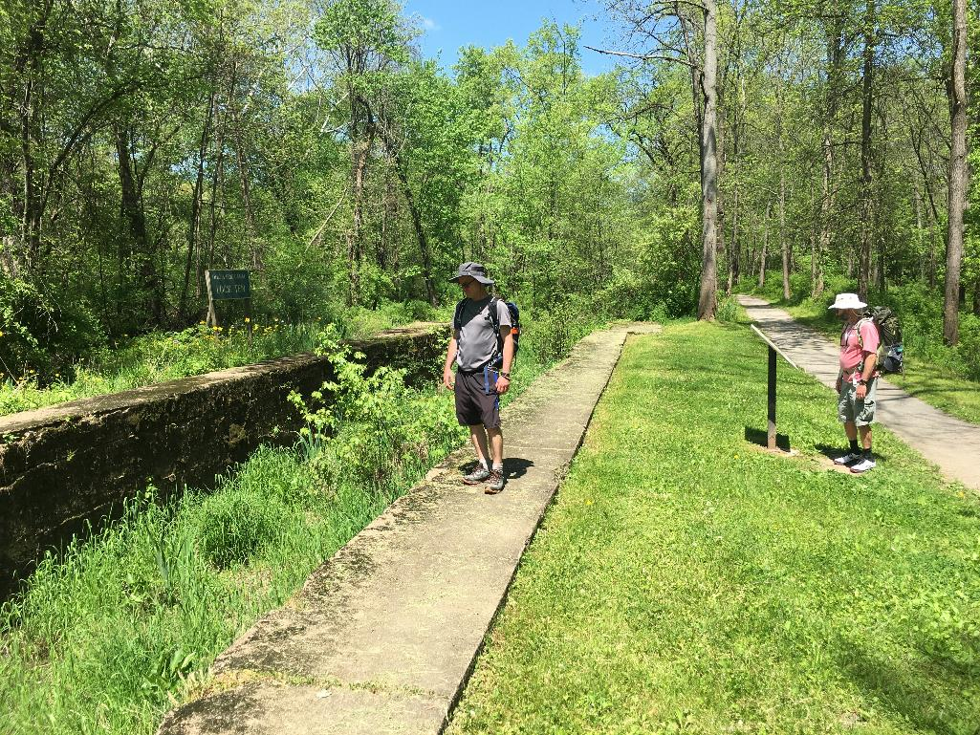
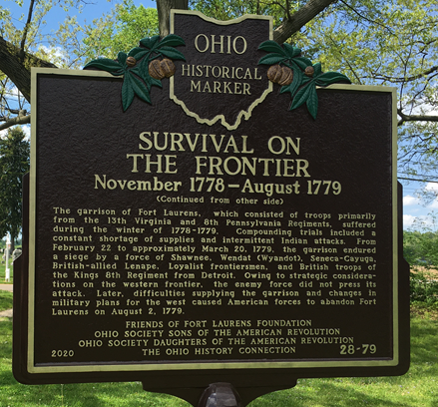
Notes:
We saw the remains of several locks, toured historic Fort Laurens, the only Revolutionary war fort in Ohio, and finished at the Lockport Brewery where we were met by Toby, Evie, cousin Heather with husband Ron, and Bethany, who all joined us at AirBnB for a feast of Tilapia, gallo pinto, and roasted tomatoes prepared by Rob.

Slide 6
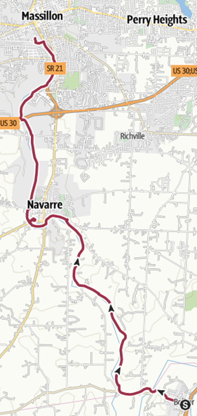
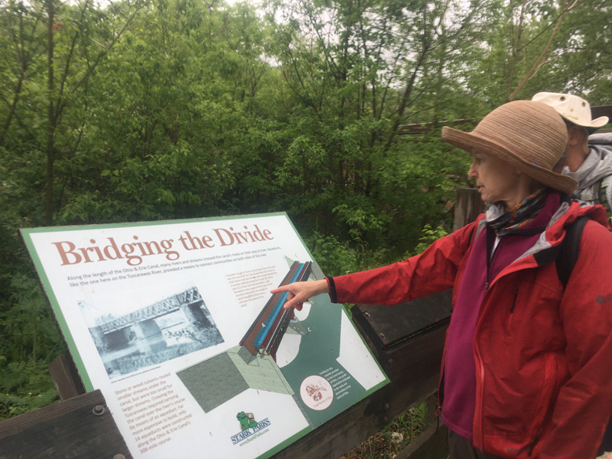
Notes:
Day 2 from Bolivar to Massillon started with light rain in morning, but a fun day with lots of wildlife and bridge at the site of a former aqueduct where they routed the canal OVER the river! Stopped for coffee and picnic lunch in Navarre, across from building that was part of the underground railway. Carolynne drove down to join us for dinner and evening.

Slide 7
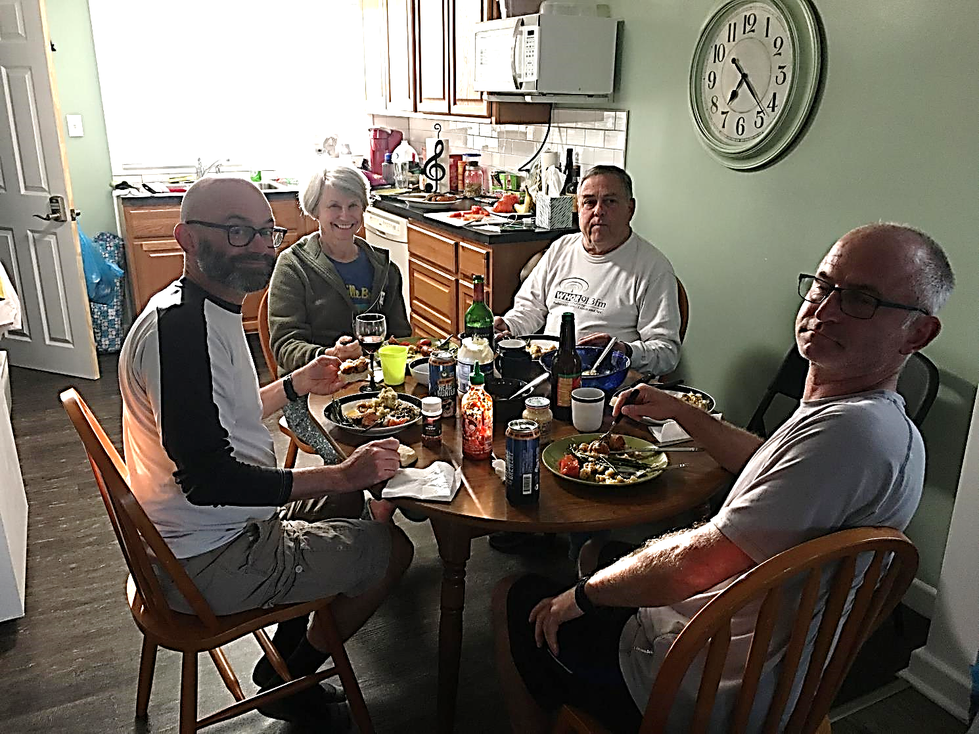
Notes:
Jody and Rob brought a ton of food from North Carolina, and Rob was our one-person support team, dropping us off in the morning, shopping and cooking during the day, and picking us up at night. We enjoyed delicious meals and good conversations, spending more time together than we had in years.

Slide 8
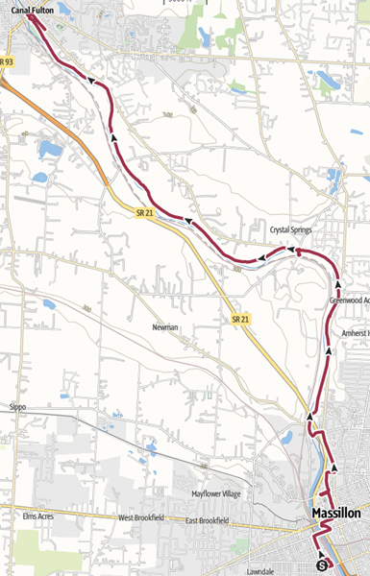
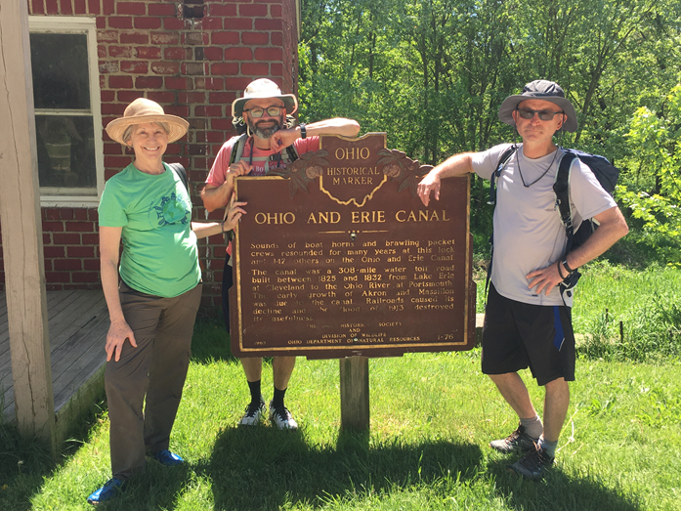
Notes:
Day 3 we walked from Massillon to Canal Fulton. Jody has a bad rash on her legs that is spreading so Rob took her to Urgent care while Dante, Omar, and I started walking. Jody was able to join us when we stopped for lunch on the pedestrian bridge at Upper Mill street. They think probably a tick bite and gave her antibiotics.

Slide 9
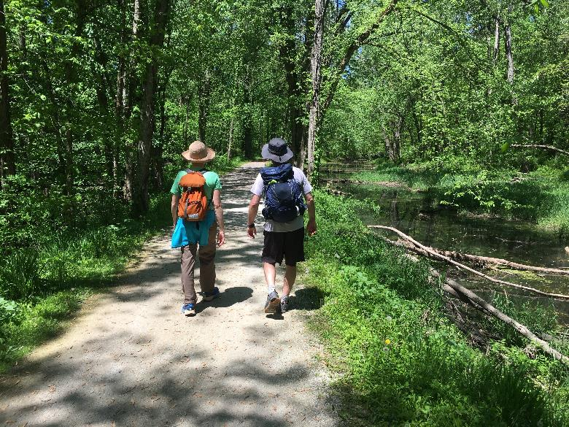
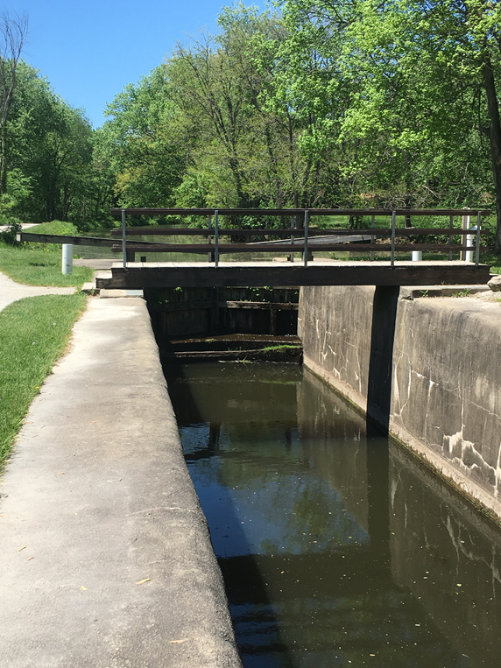
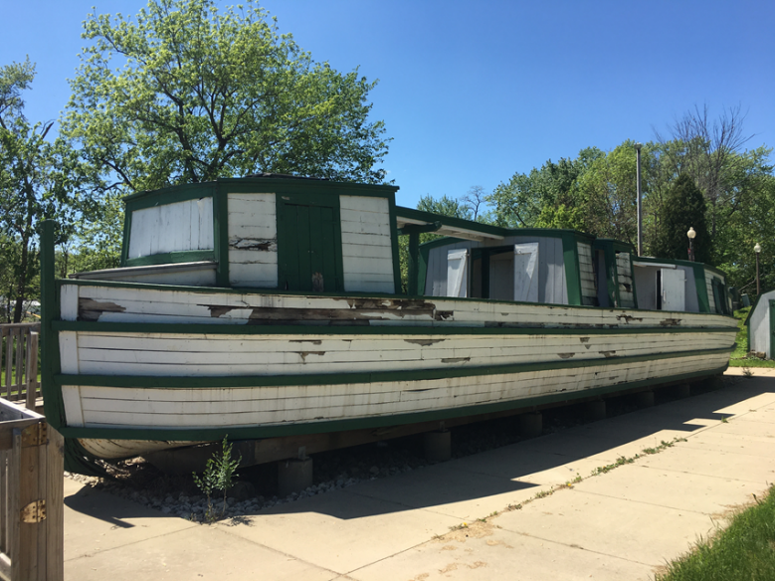
Notes:
We had lovely walking in the dappled shade along the canal today, and ended at Canal Fulton, an nice small town with the only working lock remaining on the canal, as well as the remains of one of the old wooden canal boats that only drew 18”!

Slide 10
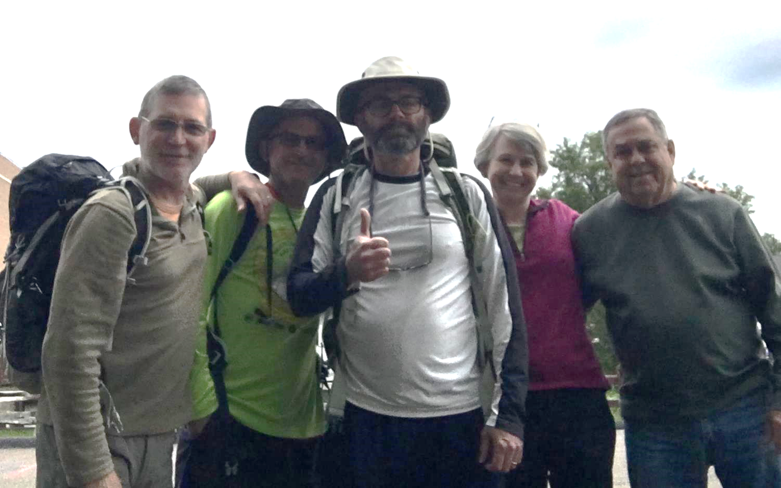
Notes:
This was Jody and Rob’s last day with us; they have to leave tomorrow morning to head back to work. We celebrated the end of our final day walking together with delicious ice cream when Rob picked us up at the Cherry Creamery right on the water in Canal Fulton.

Slide 11
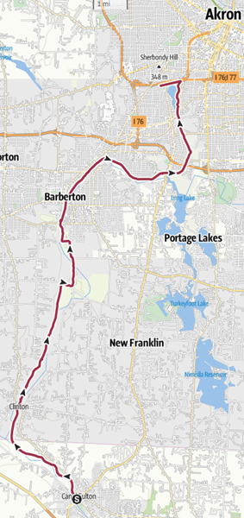
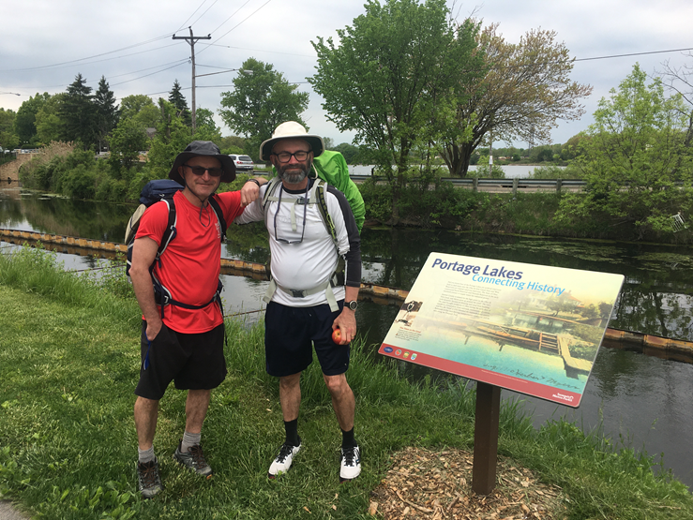
Notes:
Day 4 Dante, Omar and I had our longest distance of 19.1 miles from Canal Fulton up to Akron, past the headwaters of the Tuscarawas and Portage lakes, the highest point on the trail and a historical Native American portage between the watersheds of the south flowing Tuscarawas and the north flowing Cuyahoga rivers.

Slide 12
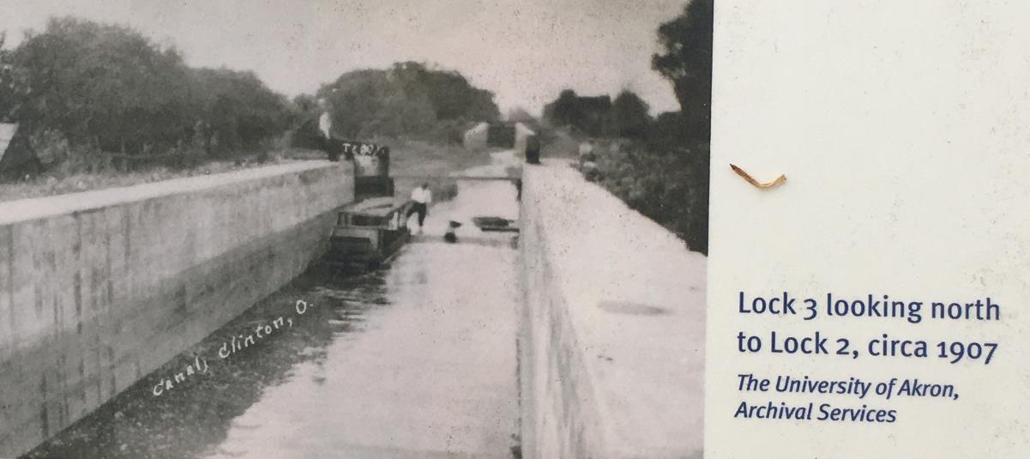
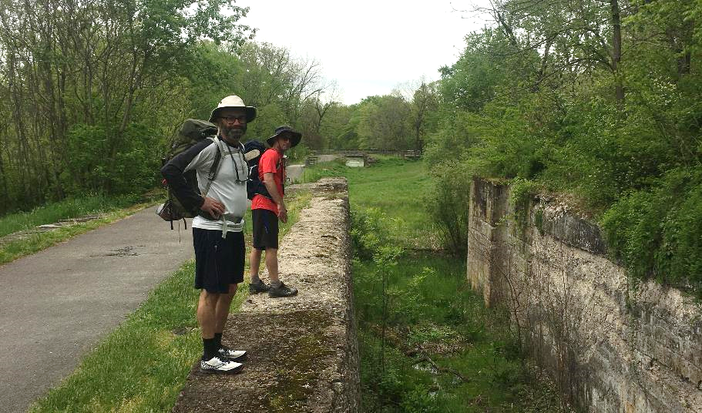
Notes:
We saw lots of historical landscapes today, including the site of locks 3 and 2 shown here below a historical photo from when the canal was still functional. We crossed Summit Lake just south of Akron on a floating boardwalk and stayed in a nearby AirBnB where we ordered pizza and watched the first half of Golden State vs Dallas basketball game before going to bed.

Slide 13
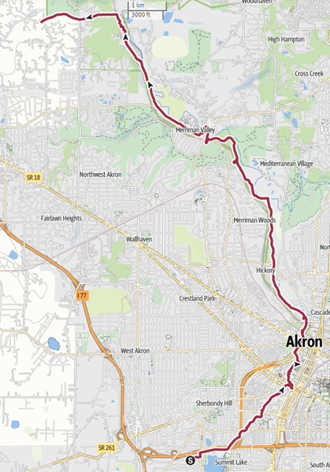
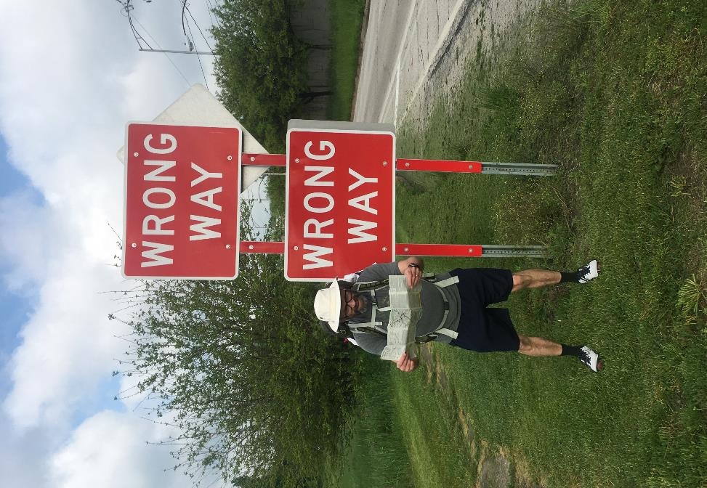
Notes:
Day 5 passed through Akron and ended at the Botzam trailhead. Mostly sunny but cool. We were guided by our peerless navigator Dante (an MIT graduate) as we continued through Akron. It is a very pleasant and historically interesting path past factories (including the giant Goodrich plant), old locks, interesting architecture, and historic buildings.

Slide 14
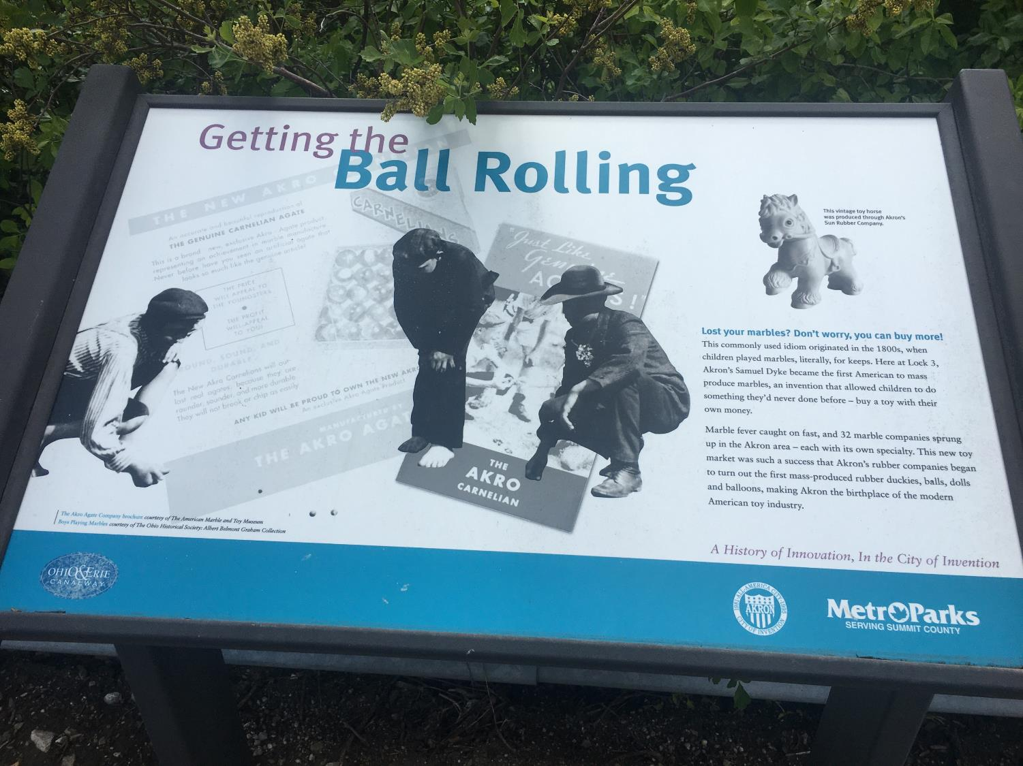
Notes:
We learned some interesting things about Akron: It is considered the birthplace of the American toy industry; at one time there were 32 independent marble companies in the area, and the huge rubber plants at one point employed 85,000 workers and produced 1/3 of all rubber products in the USA in 1950, including rubber duckies, balls, dolls, and balloons.

Slide 15
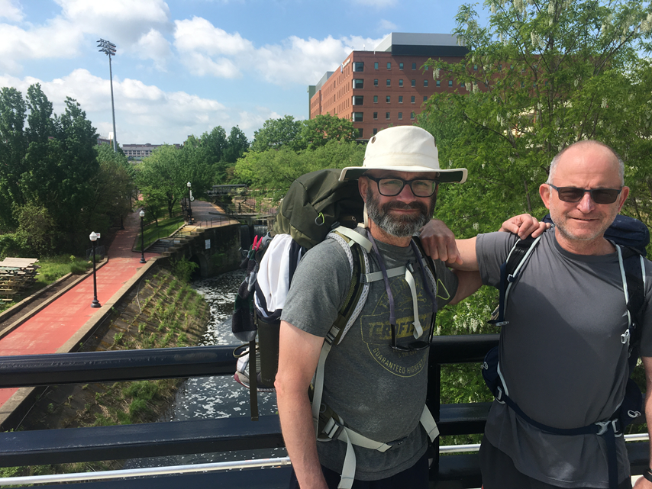
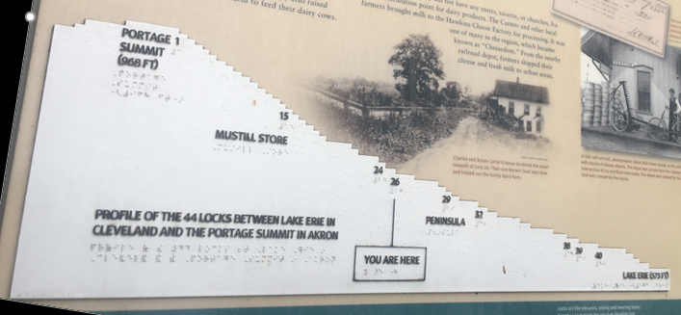
Notes:
Coming out of Akron the canal dropped steeply. We passed the remains of 15 locks in the first hour, a journey that used to take a full day on a canal boat moving through the locks. There are also the remains of quite a few old factories that used to run on the hydro power of all that water flowing downhill.

Slide 16
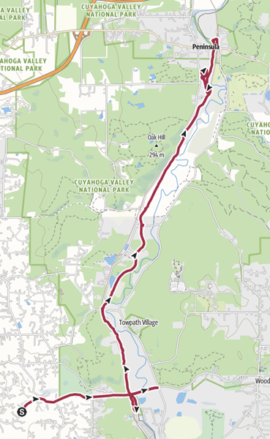
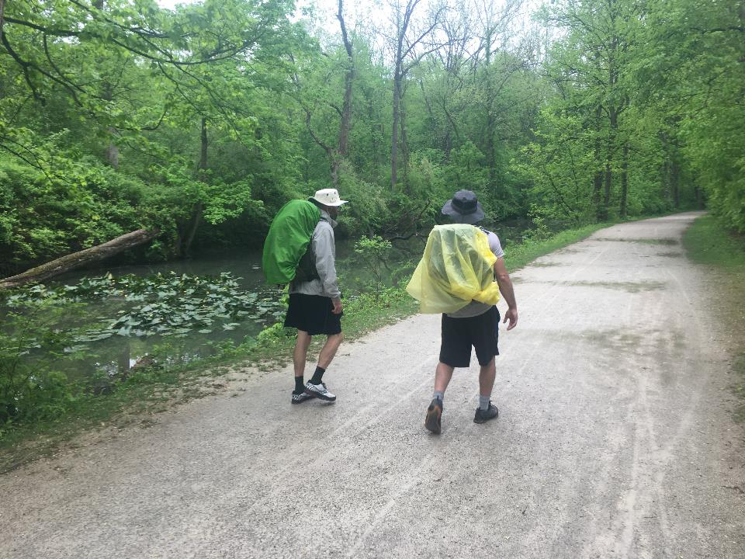
Notes:
Day 6 took us from Botzum trailhead to Peninsula and was our final day with Omar. We had rain on and off most of the day, but nice scenery along the walk including locks, ponds, and beaver dams. When we arrived in Peninsula we were tired and thirsty, so each of us downed two cold IPAs at the Winking Lizard.

Slide 17
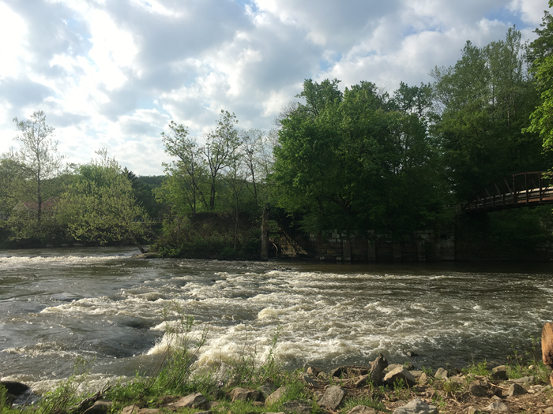
Notes:
Peninsula is a lovely little town with some nice rapids where we saw our first kingfisher of the walk! Dante had booked the top floor of the Cheese Factory BnB, overlooking the river and with a really nice rustic décor. We showered then headed to Fisher’s Restaurant for a decadent dinner with cheddar bacon fries appetizer, followed by ribs!

Slide 18
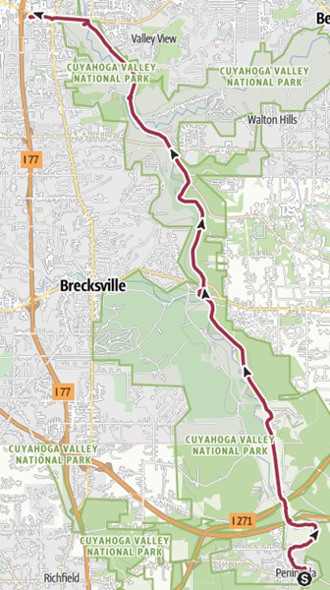
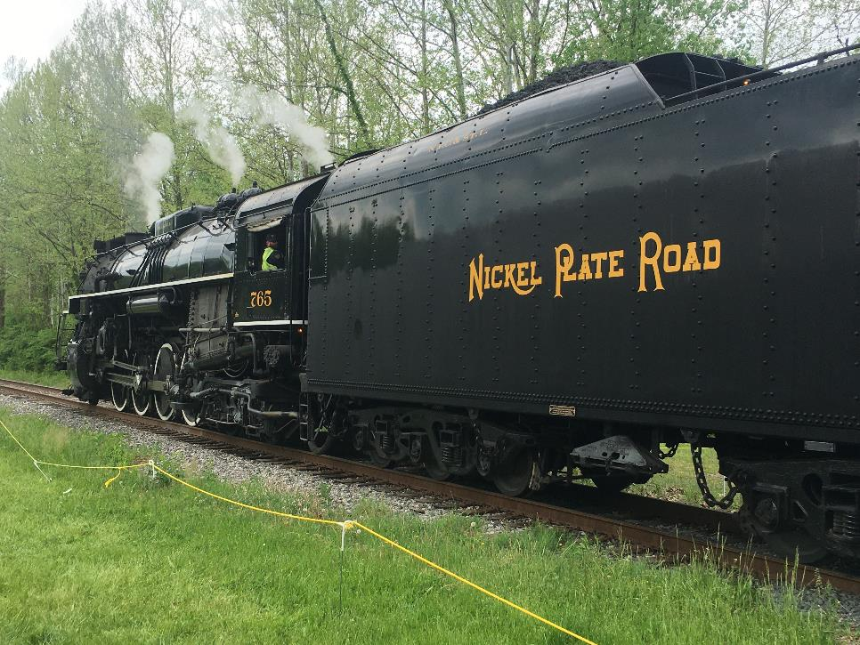
Notes:
Day 7 from Peninsula to Independence. Omar left us after breakfast of homemade granola with goats milk we bought from the local farm store. Dante and I had a nice day of walking but the hottest and most trying yet for both of us. We travelled mostly along towpath passing locks 29-39. Our picnic lunch was at Brecksville Station where there is a famous bridge and we saw the historic steam train.

Slide 19
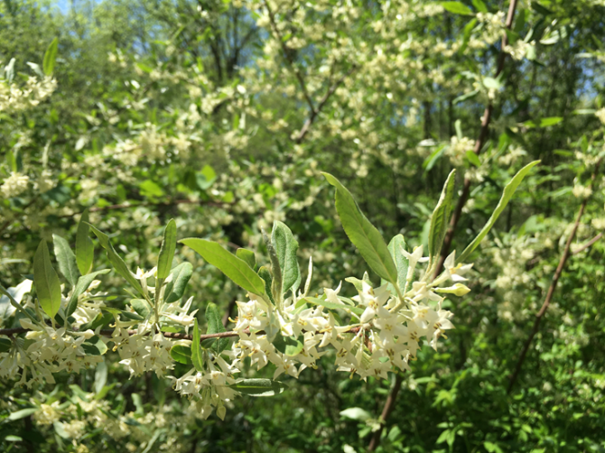
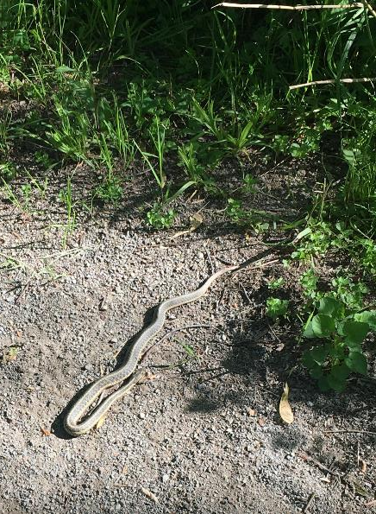
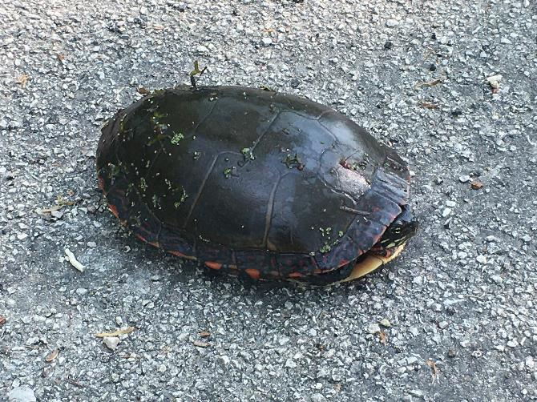
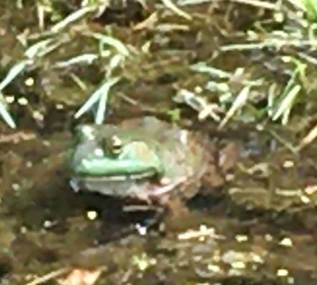
Notes:
All 8 days of the hike we saw wildlife including deer, muskrats, fox, hundreds of turtles (painted and snapping), garter snake, lots of birds including bald eagle, osprey, humming bird, indigo buntings, pileated woodpecker, mallards and Canada geese with young, wood ducks, hawks, vultures, fish including carp and Northern Hogsucker fish, and bullfrogs. Also many nice plants including maple, oak, shag bark hickory, linden, and flowers including yellow violets and fragrant white blooming shrubs.

Slide 20
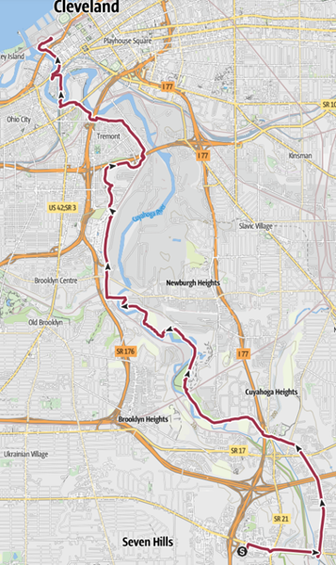
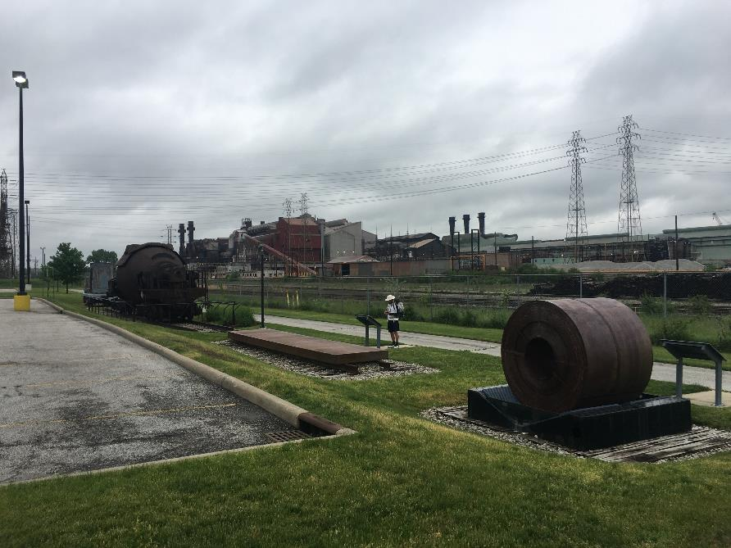
Notes:
After dinner at the Melt and sleeping at the Red Roof Inn, we awoke and had breakfast at Bob Evans for our final walk to Lake Erie in Cleveland. It was a surprisingly nice path through the suburbs and then industrial areas of Cleveland, eventually heading down into the flats where we finished at Port of Cleveland. We met Carolynn and Bethany (who had just run the marathon!) and Omar at Collision Bend Brewery to celebrate. A great end to a great walk.

